Slide 1

CYBER CRIME
Presented By :
SHAGUN & SURUCHI

Slide 2

INTRODUCTION
Cybercrime or a computer-oriented crime is a crime that includes a computer and a network. The computer may have been used in the execution of a crime or it may be the target. Cybercrime is the use of a computer as a weapon for committing crimes such as committing fraud, identity theft, or breaching privacy.

Slide 3


DEFINING CYBER CRIME
Cybercrime is criminal activity that either targets or uses a computer, a computer network or a networked device. Most cybercrime is committed by cybercriminals or hackers who want to make money. However, occasionally cybercrime aims to damage computers or networks for reasons other than profit.

Slide 4
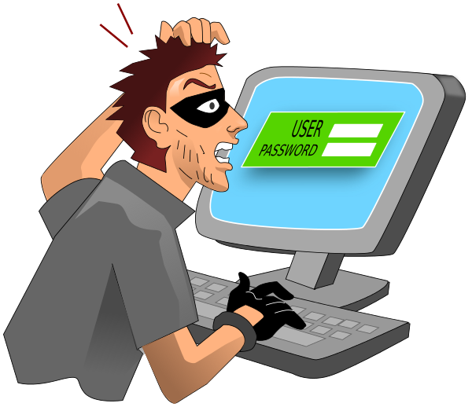
TYPES OF CYBER CRIMES
Phishing
Hacking
Malware
Email Bombing
Spamming
Cyber bullying
Cyber stalking
Theft
Virus dissemination

Slide 5
SAFETY TIPS FOR CYBER CRIME
Turn on Multifactor Authentication Implement multifactor authentication on your accounts and make it significantly less likely you’ll get hacked.
Update Your Software Update your software. In fact, turn on automatic updates.
Think Before You Click
Think before you click. More than 90% of successful cyber-attacks start with a phishing email.
Use Strong Passwords Use strong passwords, and ideally a password manager to generate and store unique passwords.

Slide 6

The technique of protecting internet-connected systems such as computers, servers, mobile devices, electronic systems, networks, and data from malicious attacks is known as cybersecurity. We can divide cybersecurity into two parts one is cyber, and the other is security. Cyber refers to the technology that includes systems, networks, programs, and data. And security is concerned with the protection of systems, networks, applications, and information. In some cases, it is also called electronic information security or information technology security.

Slide 7



ADVANTAGES OF CYBER SECURITY
Protection of Sensitive Data
Business Continuity
Enhanced Customer Trust
Early Detection and Response
Enhanced Collaboration

Slide 8

CONCLUSION
We can say that Cyber Crime is a dangerous offense to someone’s privacy or any material.
Also, we can avoid Cyber Crime by following some basic logical things and using our common sense. Above all, Cyber Crime is a violation of not only law but of human rights too.

Slide 9


This presentation designed by: Shagun & Suruchi

